Slide 1
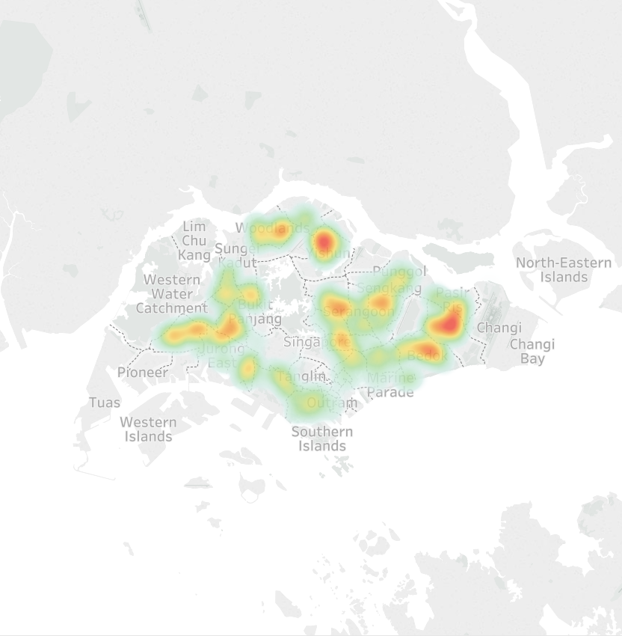
Singapore HDB Resale Analysis
Feng Dan
~800k HDB resale data since 1990

Slide 2
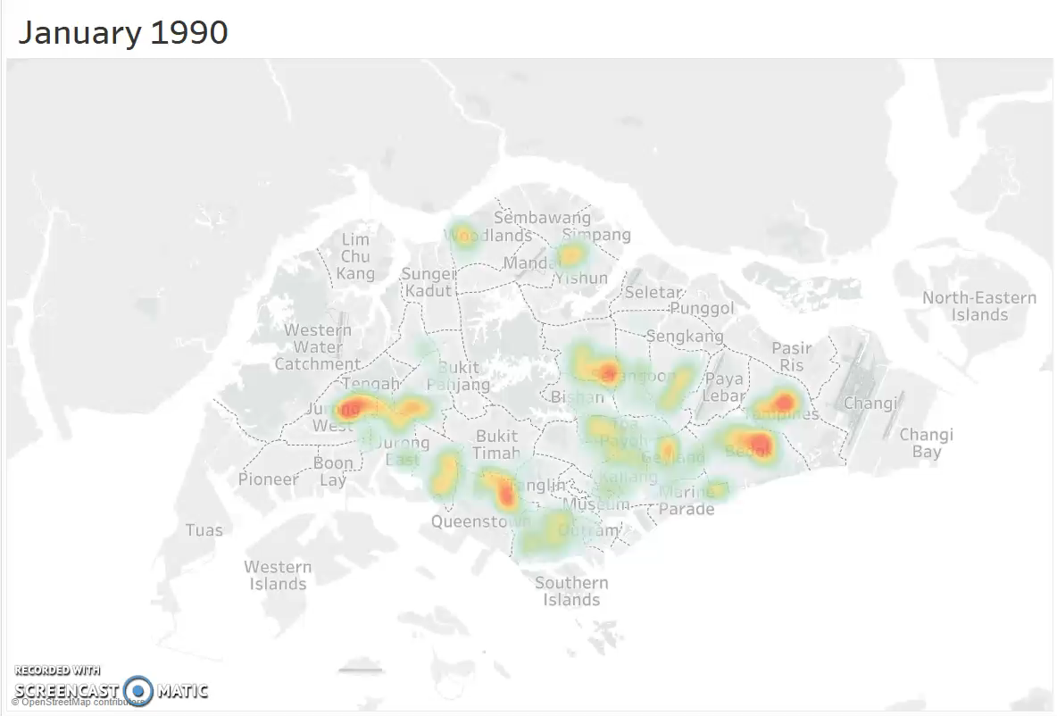
History of HDB resale records density map (1900 to now)
Video shows:
Number of the transactions decreased after 2013
Number of transactions increased from 2017, especially in Punggol and Jurong West areas

Slide 7
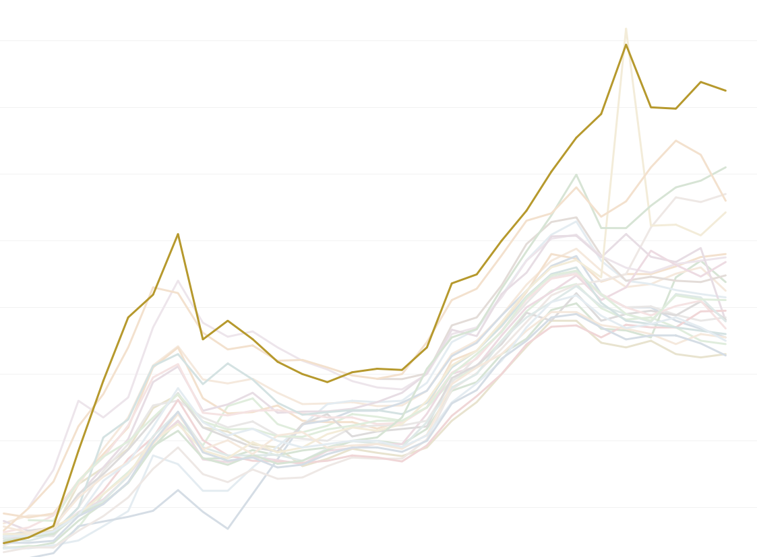
BUKIT TIMAH has the largest increase in price
2019
$725,000
1990
$46,500

Slide 8
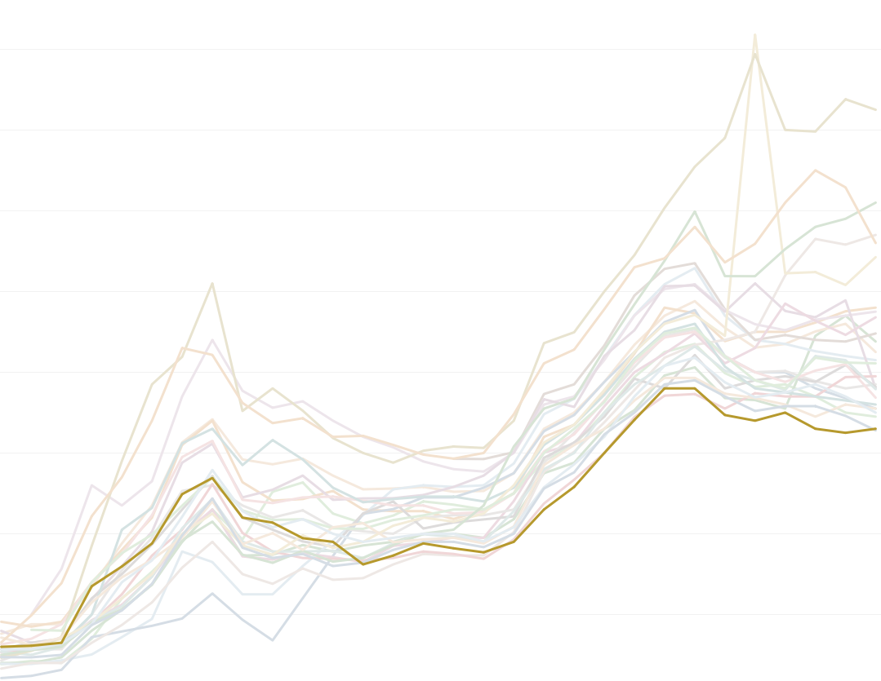
YISHUN has the smallest increase in resale price
2019
$328,000
1990
$60,000

